Slide 1
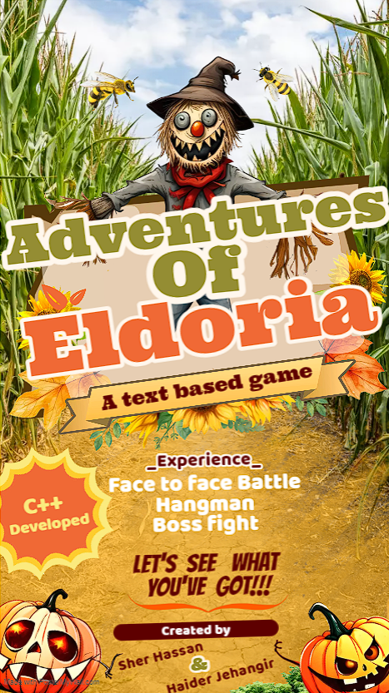
Project Made by:
Sher Hassan
01-131232-084
Haider Jahangir
01-131232-026

Slide 2
Program Report: Adventures of Eldoria
Overview of Code
The Adventures of Eldoria is a text-based adventure game implemented in C++. The code is structured into distinct stages, each representing a crucial phase in the heroic journey to save Eldoria from the encroaching darkness. The program leverages a combination of game mechanics, including battles, puzzles, and interactive decision-making, to engage the player in an immersive fantasy world

Slide 3

Storyline
In the mystical world of Eldoria, a powerful artifact known as the Crystal of Eternity has been shattered into three pieces, scattering its immense energy across the lands. These fragments hold the key to either the salvation or doom of Eldoria. Dark forces led by the malevolent sorcerer Morgaroth seek to harness this power for their nefarious purposes, plunging the world into eternal darkness. The fellowship of heroes must rise to prevent this cataclysmic event.

Slide 4
Stage 1: The Battle for Dawn
The journey begins in the peaceful realm of Elaria, where the first fragment is hidden. Players can choose from a diverse group of characters, each with their own unique abilities and weapons. The player's party must defend the sacred grounds against waves of Morgaroth's minions. The defender, armed with a shield and heavy armor, holds the line against the relentless attackers, while the attacker, a skilled warrior, strikes down foes with a variety of weapons. As the battle intensifies, players must coordinate their attacks and defenses to protect the fragment.

Slide 5

Stage 2: Riddles of the Forgotten Oracle
Having secured the first fragment, the fellowship travels to the ancient library of Mystaria to consult the Forgotten Oracle. To decipher the ancient runes and unveil the secrets of the Crystal's location, players engage in a Hangman game. Correct guesses reveal clues, and incorrect guesses bring the fellowship one step closer to failure.

Slide 6
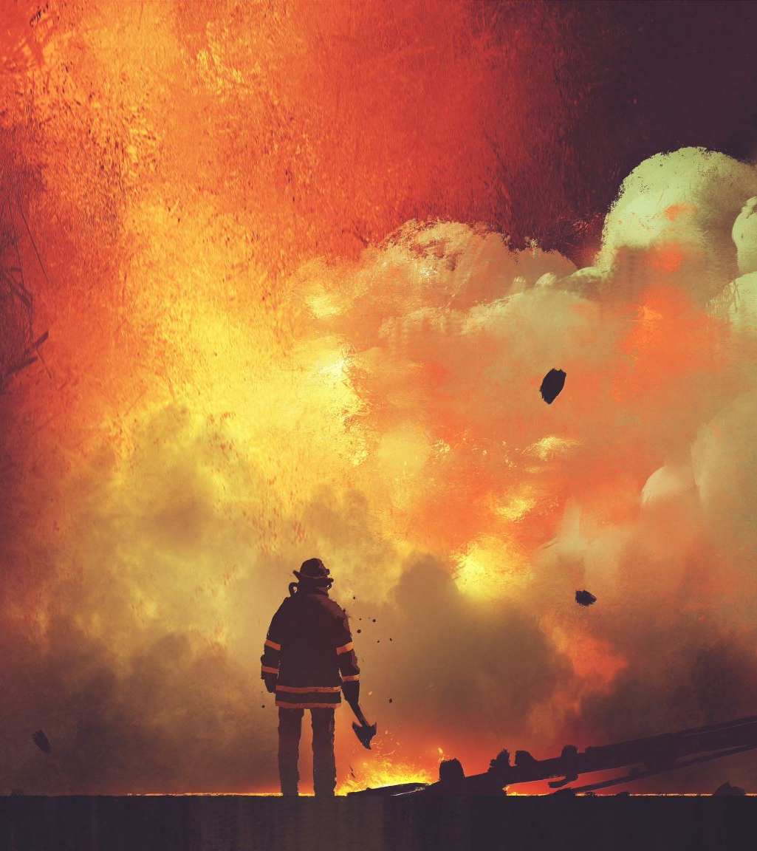
Final Boss Fight: Morgaroth's Last Stand
With all three fragments in their possession, the fellowship confronts Morgaroth in his lair atop the Black Spire. The final showdown tests the heroes' strength, wits, and teamwork as they face Morgaroth's dark magic and summon minions. Each character's unique abilities and weapons play a crucial role in overcoming Morgaroth's defenses. Victory depends on the fellowship's ability to synchronize their attacks, exploit weaknesses, and ultimately shatter the Crystal of Eternity to save Eldoria from impending doom.The fate of Eldoria rests in the hands of the fellowship, and the players must rise to the challenge to ensure the realms of eternity remain bathed in the light of hope.

Slide 7
Features
Character Selection: Players can choose from a variety of characters, each contributing differently to the gameplay.
Interactive Games: The inclusion of Hangman games adds an interactive and challenging dimension to the storyline.
Progression System: The XP (experience points) system provides a sense of achievement and progression throughout the game.
Dynamic Battles: The turn-based battle system adds strategic depth to the gameplay

Slide 8

HANGMAN MINI GAME
Players engage in a pivotal test of intellect and teamwork.
Guess letters to reveal the codeword.
Failure adds tension to the overarching narrative

Slide 9

Work Experience
The development of Eldoria's Quest was a collaborative effort, bringing together the skills and expertise of two developers:
Developer 1 (SHER HASSAN)
Role: Lead Programmer and Game Designer
Contributions: Implemented core game mechanics, designed and structured code, integrated interactive elements, and crafted the overall storyline.
Developer 2 (HAIDER JAHANGIR)
Role: Graphic Designer and Creative Writer
Contributions: Developed Storyline, Developed visual assets, designed character concepts, and contributed to the narrative and dialogues, assisted in programming, enhancing the overall immersive experience.
The collaboration resulted in a cohesive and engaging text-based adventure game that combines coding proficiency with creative storytelling and design.

Slide 10
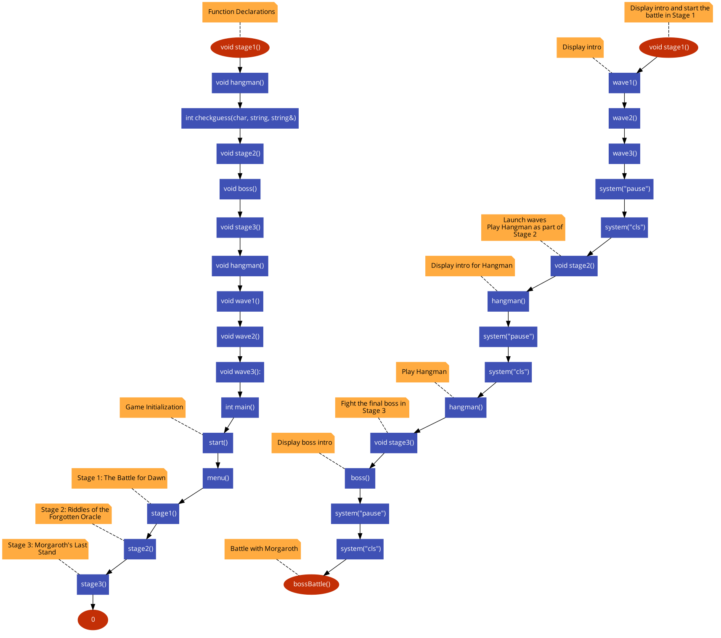

Slide 11
GitHub Repository
https://github.com/Shadowx69/CP/blob/faaa66f51e17b1d406247d5edd365c8a00edefb9/tut.cpp

